Slide 1
Marshall Bruce Mathers III
Anoir Koolhoven|A6B

Slide 2
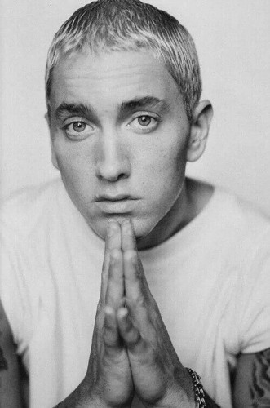
EMINEM
Marshall (Bruce) Mathers III = M&M = Eminem
Brain Damage (MM LP1)
GOAT

Slide 3
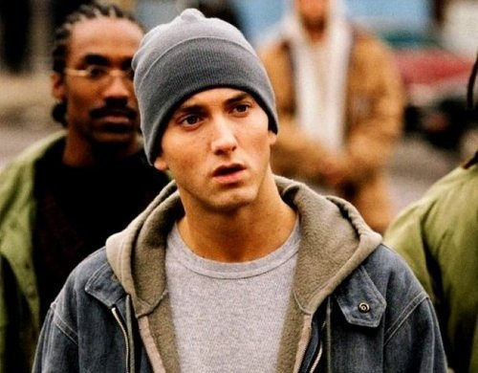
EMINEM
Best selling hip-hop artist
One of the best world’s best-selling artists
15 Grammy’s total
Academy Award for Best Original Song (8 Mile)

Slide 4
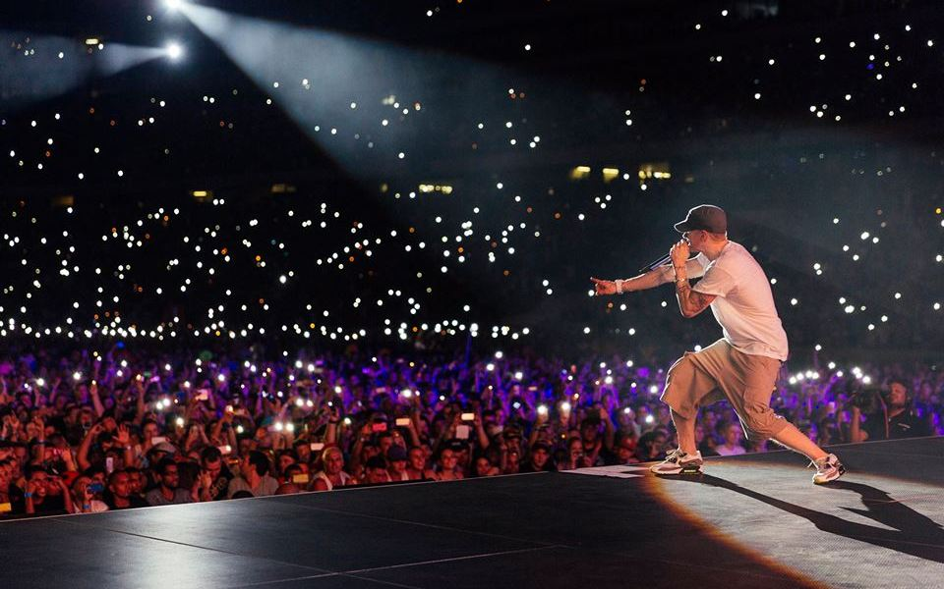
Albums
Infinite, 1996
The Slim Shady EP, 1997
The Slim Shady LP
The Marshall Mathers LP1, 2000
The Eminem Show, 2002
Encore, 2004
Relapse, 2009
Recovery, 2010
MMLP2, 2013
Shady XV, 2014

Slide 5
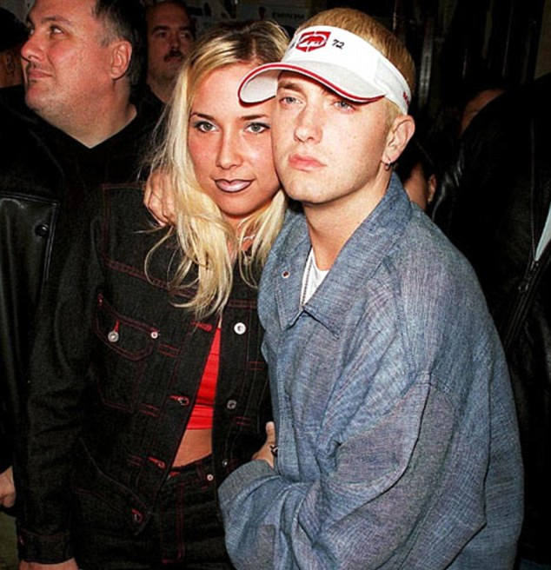
EMINEM
Divorced from Kim Mathers
3 daughters
● Hailie
● Whitney
● Alaina
Lyrical genius

Slide 6
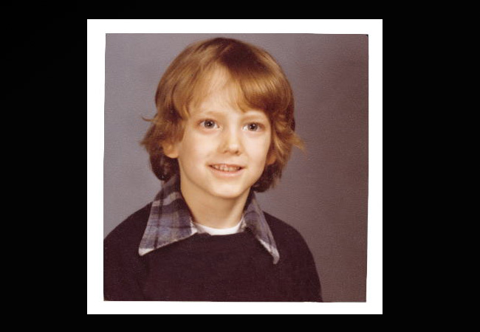
Childhood
Born in Missouri 17 Oct. 1972
Debbie Mathers & Marshall Mathers Jr.
Very rough
Bad student
Debbie & sleep medication

Slide 7
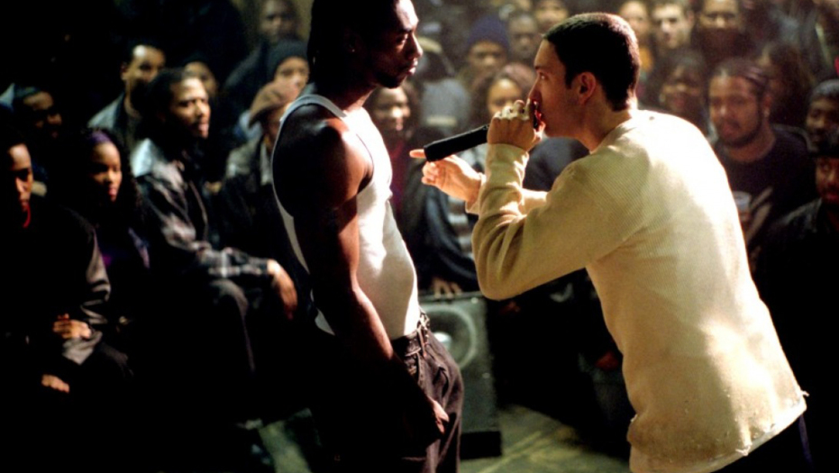
Skills?
● beats
● Storytelling
● Freestyle
● flow

Slide 8
Skills?
● beats
● Storytelling
● Freestyle
● flow

Slide 9
Skills?
● beats
● Storytelling
● Freestyle https://www.youtube.com/watch?v=ZLFQOUjQATI
● flow

Slide 10
Skills?
● beats
● Storytelling
● Freestyle
● flow

Slide 11
Skills?
● beats
● Storytelling
● Freestyle
● flow

