Slide 1
The discovery of metallic hydrogen
By Anoir Koolhoven

Slide 2
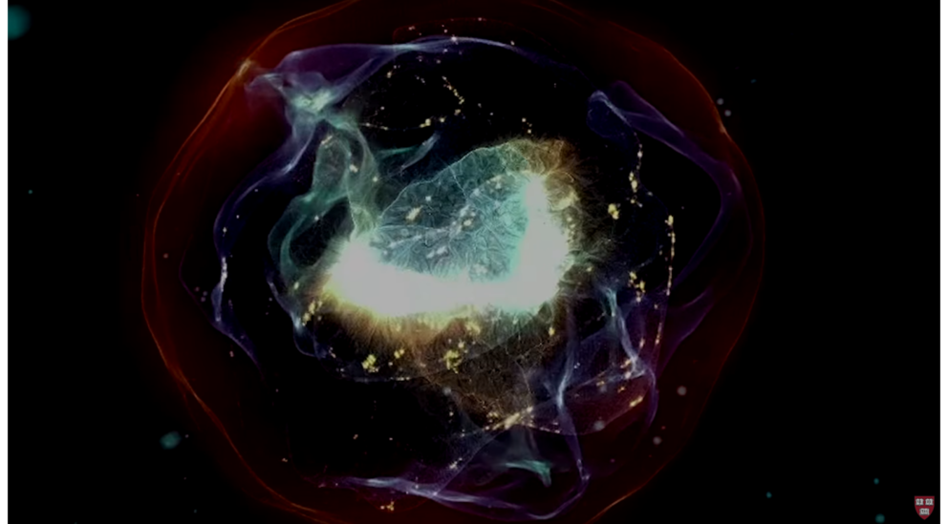
Colorized image of metallic hydrogen
The discovery
The end of January
Pressure > Earth’s center

Slide 3
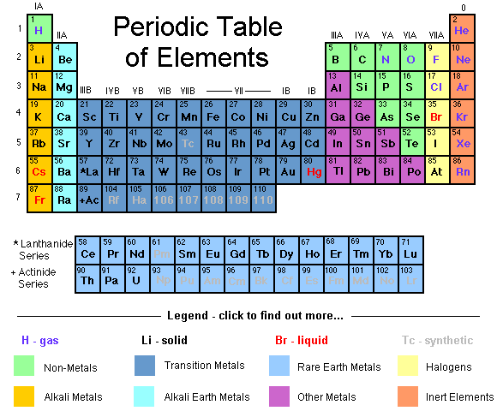
What is hydrogen?

Slide 4
The experiment
With a pressure of 25 million Pascal
The sample reflects 90% of the light that hits it

Slide 5
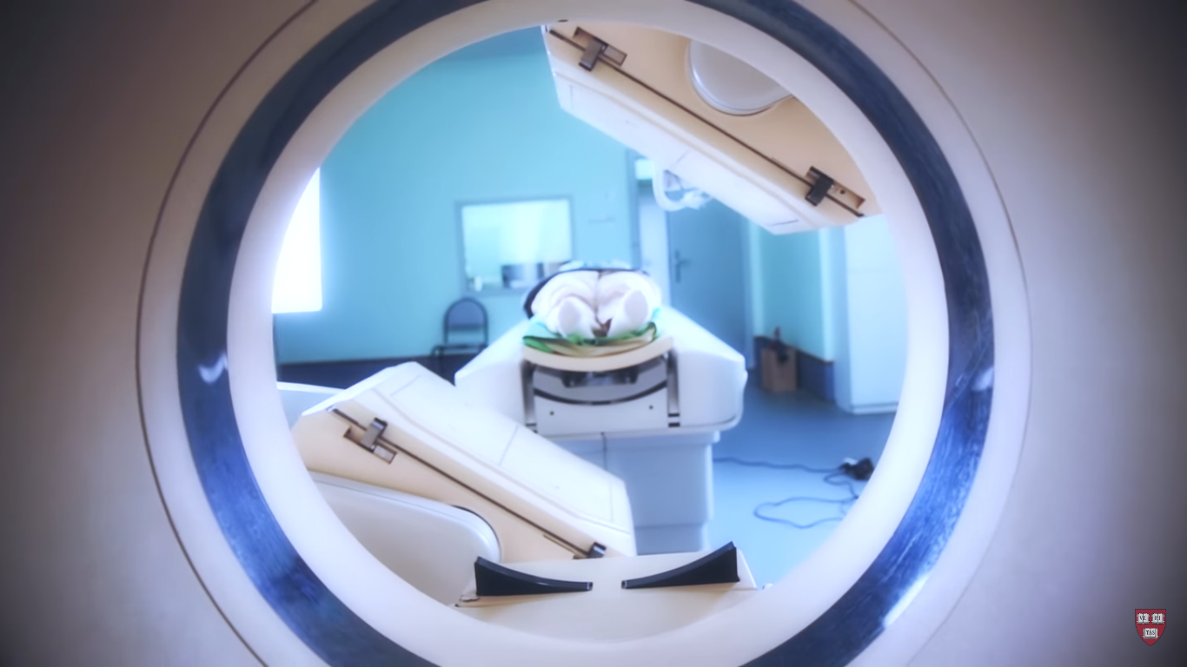
Its significance
Revolutionize space exploration
Possibly a room-temperature superconductor.

Slide 6
Quote
“This is the Holy Grail of high-pressure physics.
It’s the first-ever sample of metallic hydrogen on Earth, so when you’re looking at it, you’re looking at something that’s never existed before.”
– Isaac. F. Silvera

