Slide 1
News
Annelinde van Hunnik
en
Myrthe de la Fuente

Slide 2
Topics
Justin Bieber
The White House
Robots
Max Verstappen
Weather

Slide 3
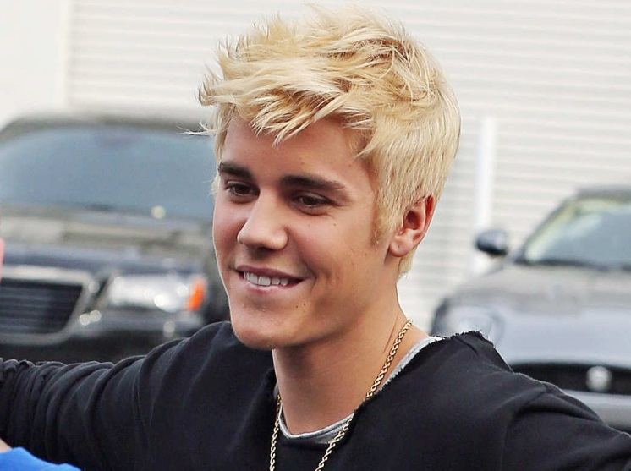
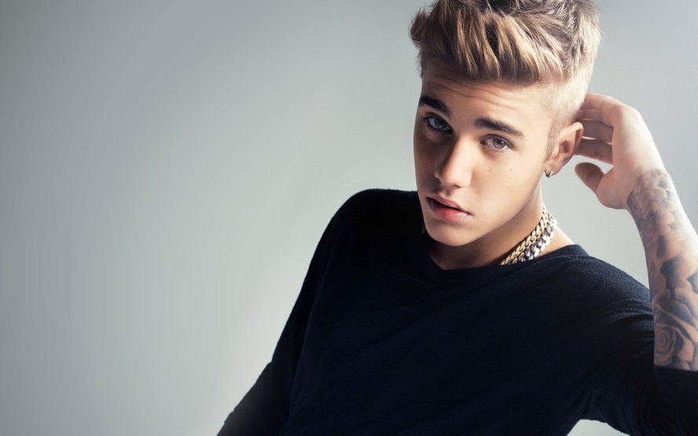
Justin Bieber
New album.
Singing for Selena Gomez.

Slide 4
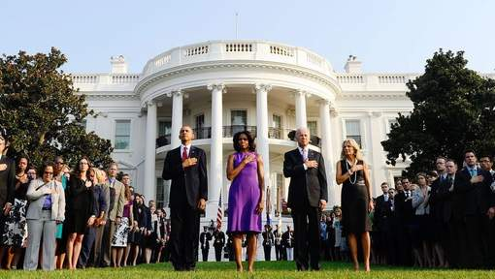
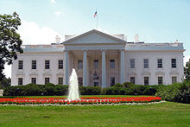
The White House
A man jumped over the fence.
Oboma was inside when it happened.

Slide 5
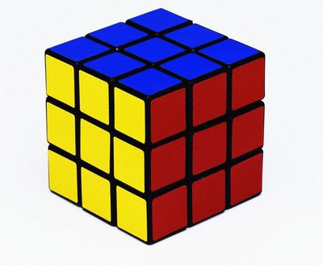
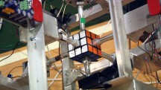
Robots
A robot complete a rubiks cube in 2,39 sec.
The robot has 6 arms.
It’s the first robot who can do this.

Slide 6
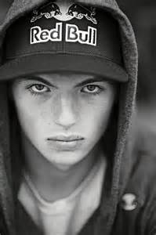
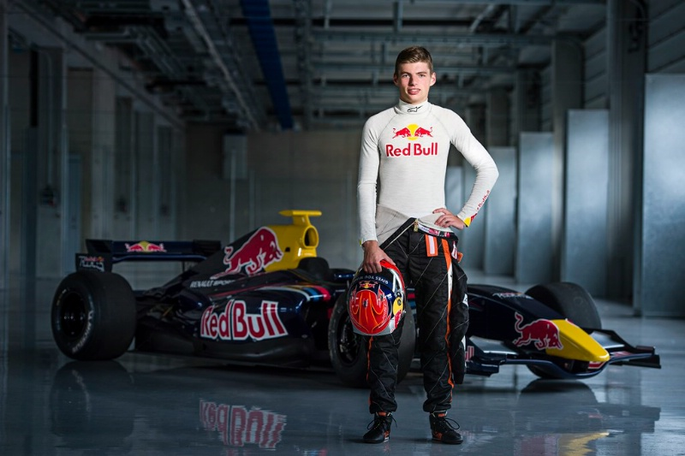
Max Verstappen
Max Verstappen wins 3 awards by the FIA Prize-Giving gala.
his father think he will do very well next year.

Slide 7
Weather
Thursday: 8° it’s cloudy en rainy
Friday: 8° it’s cloudy en sunny
Saturday: 8° it’s sunny
Sunday: 7° it’s very cloudy

