Slide 1
Cancer
Joy Mennings and Joyce Lomans

Slide 2
Contents
Why did we choose this subject?
Why is cancer a social issue?
What is cancer?
Most common kinds of cancer
What causes cancer?
Cancer in Europe
Our opinions
Questions?

Slide 3
Why did we choose this subject?
Family
Consequences

Slide 4
Why is cancer a social issue?
Many people
Social and emotional issues
Physical issues
Friends and family

Slide 5
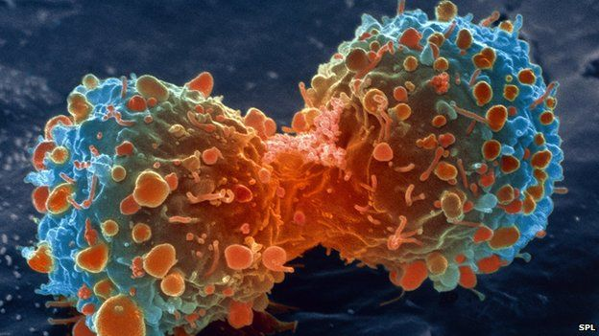
What is cancer?
Related diseases
Cells
Tumours

Slide 6
Most common kinds of cancer
Breast cancer
Prostate cancer
Colon cancer
Skin cancer
Lung cancer
Children with cancer
CAUTION-list

Slide 7
What causes cancer?
Genetic disease
Sun and SUV
Radiation exposure

Slide 8
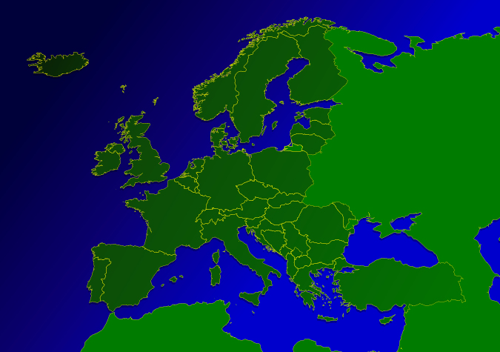
Cancer in Europe
ECHI-indicators
Incidence
Amount of deaths

Slide 9
Our opinions
Joy
Joyce

Slide 10
Questions?

