Slide 1
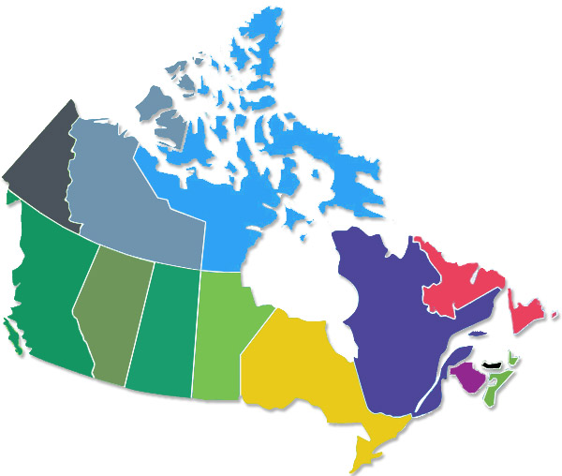
CANADA

Slide 3
