Slide 2
Suffering from Depression
A serious mental health disorder

Slide 3
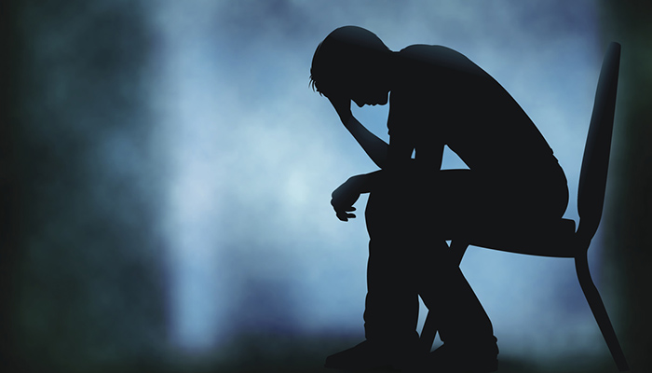
Index
What is depression?
Symptoms of depression
Causes of depression
Treatments

Slide 4
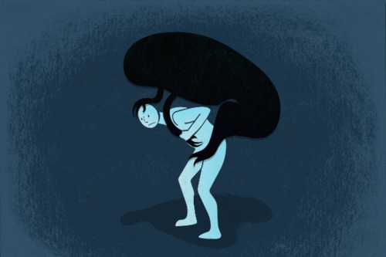
What is depression?
Depression noun /dɪˈpreʃ.ən/ UK
A mental illness in which a person is very unhappy and anxious (= worried and nervous) for long periods and cannot have a normal life during these periods).
1 in 15 adults (6.7 %)
1 in 6 people (16.7 %) will experience depression at some time in their life.
Late teens to mid-20’s

Slide 5
Symptoms of depression
Feelings
Sadness
Anger
Guilt
Hopelesness
Behaviour
Social withdrawal
Low motivation
Impaired ability to think, concentrate, or make decisions.
Thoughts
Poor self-esteem
Thoughts of suicide and self-harm
Physical health
Difficulty sleeping or excessive sleeping
Tiredness or lack of energy
Changes in apetite
Clusters of symptoms occurring nearly everyday for at least 2 weeks.
Cyclical symptoms

Slide 6
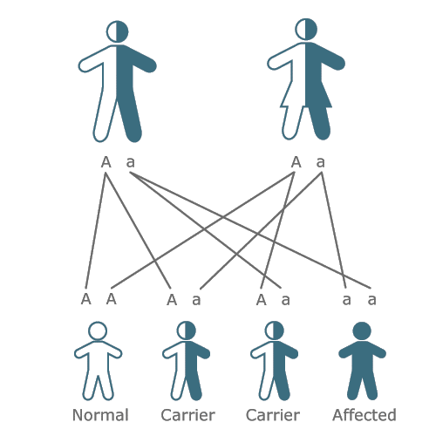
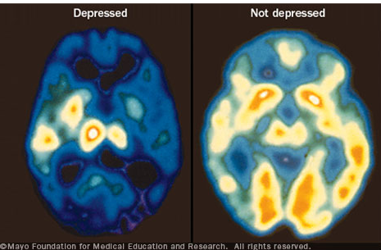
Causes of depression
Several factors that can play a role in depression:
Personality
Genetics
Environmental factors
Biological factors

Slide 7
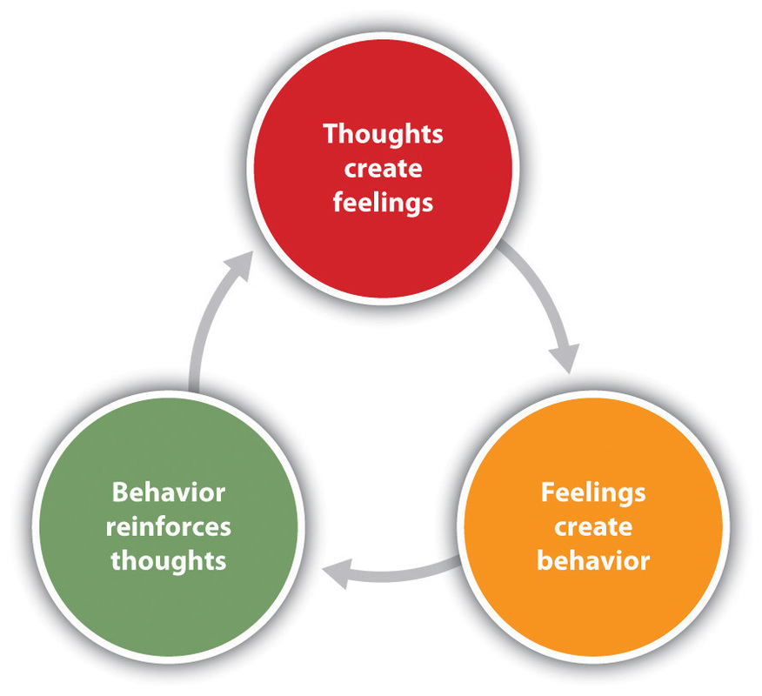
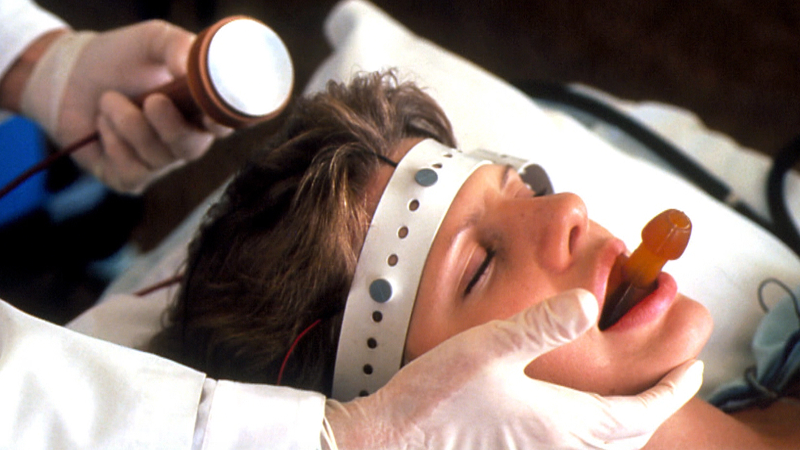
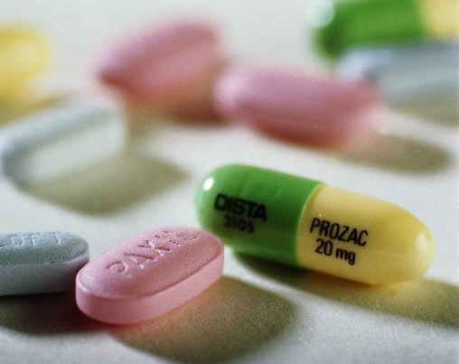
Treatments
80 – 90 % respond well to treatment
Treatment will be based on whether a person has mild, moderate or severe depression.
Medication
Antidepressants
Talk therapy
Cognitive Behavioural Therapy
Psychotherapy
Electroconvulsive therapy (ECT)

Slide 8
The End
{naam}
havo

